Slide 1
CS2S562
Secure Software Development
Integer Security

Slide 2
Risk = S x L x R
Severity - How serious are the consequences
  1 = low (denial-of-service attack, abnormal termination)
  2 = medium (data integrity violation, unintentional information disclosure)
  3 = high (run arbitrary code, privilege escalation)
Likelihood - How likely is it an exploitable vulnerability
  1 = unlikely
  2 = probable
  3 = likely
Remediation Cost - How expensive is it to fix
  3 = high (manual detection and correction)
  2 = medium (automatic detection and manual correction)
  1 = low (automatic detection and correction)

Slide 3
Integer Vulnerabilities
Lang. | Description | Severity | Likelihood | Remediation Cost | Risk
C | Unsigned integer wrap | 3 | 3 | 3 | 27
C | Signed integer overflows | 3 | 3 | 3 | 27
C | Loss of data due to type-casting | 3 | 2 | 3 | 18
C | Division and remainder resulting in divide-by-zero | 1 | 3 | 2 | 6
C | Integer <–> pointer conversions | 1 | 2 | 3 | 6
C++ | Out of range enumeration values | 2 | 1 | 2 | 4
C | Negative bit shifts | 1 | 1 | 2 | 2
C | Incorrect integer precisions | 1 | 1 | 2 | 2
Table data source CERT.org
Possible Values: 1, 2, 3, 4 6, 8, 9 12, 18, 27
Note: ‘C’ in above table means ‘C and C++’

Slide 4
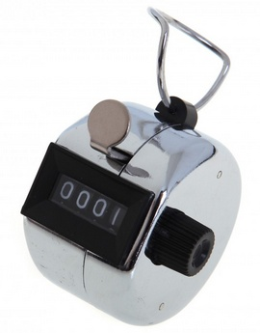
Unsigned Integers
C++ types
  unsigned char
  unsigned short int
  unsigned int
  unsigned long int
  unsigned long long int (C++11)
  Where is the problem? Programmers know the lengths (in bytes) of all of these, don’t they?
Here is the rub:
  The amount of bytes in the above types depends on compiler and platform used

Slide 5
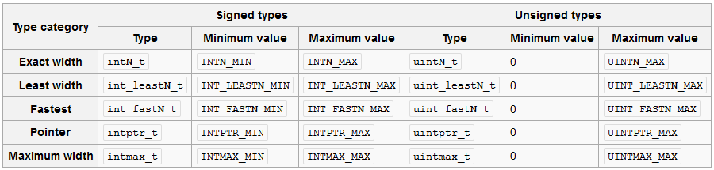
Unsigned Integers
Therefore use C99 (or higher) data types:
  In C: <inttypes.h>, C++: cinttypes header
  (alternatively: C: <stdint.h>, C++: cstdint header)
  Defined length → portability & compiler independence
good for ‘if’ checks
e.g. uint32_t x=5;
From Wikipedia:

Slide 6
Unsigned Integers
Why should I use an unsigned integer?
  Convey to reader the expected range of values that a variable may take on.
  They are more efficient.
  Modulus arithmetic is completely defined.
  Overflowing an unsigned data type is defined, whereas overflowing a signed integer results in undefined behaviour
  You can safely perform shift operations
  Larger dynamic range.
So, what’s the problem?

Slide 7
Unsigned Integer Wrap
The number 14 in computer memory:
16 bit
1 bit
1 byte
1 byte
0 | 0 | 0 | 0 | 0 | 0 | 0 | 0 | 0 | 0 | 0 | 0 | 1 | 1 | 1 | 0
32,768
128
16
8
4
2
1
2¹⁵
2⁷
2²
2¹
2⁰
8 + 4 + 2 = 14

Slide 8
Unsigned Integer Wrap
If we add 1 then the result is:
16 bit
1 byte
1 byte
0 | 0 | 0 | 0 | 0 | 0 | 0 | 0 | 0 | 0 | 0 | 0 | 1 | 1 | 1 | 1
32,768
128
16
8
4
2
1
2¹⁵
2⁷
2²
2¹
2⁰
8 + 4 + 2 +1 = 15

Slide 9
Unsigned Integer Wrap
Adding 1 more “flips” the first 4 bits to ‘0’:
16 bit
1 byte
1 byte
0 | 0 | 0 | 0 | 0 | 0 | 0 | 0 | 0 | 0 | 0 | 0 | 1 | 1 | 1 | 1
0 | 0 | 0 | 0 | 0 | 0 | 0 | 0 | 0 | 0 | 0 | 1 | 0 | 0 | 0 | 0
32,768
128
16
8
4
2
1
2¹⁵
2⁷
2²
2¹
2⁰
16 + 0 + 0 + 0 + 0 = 16
8 + 4 + 2 +1 = 15

Slide 10
Unsigned Integer Wrap
The highest number possible is:
16 bit
1 byte
1 byte
1 | 1 | 1 | 1 | 1 | 1 | 1 | 1 | 1 | 1 | 1 | 1 | 1 | 1 | 1 | 1
32,768
128
16
8
4
2
1
2¹⁵
2⁷
2²
2¹
2⁰
32,768 +16,384 + 8,192 + . . . . + 2 + 1 = 65,535

Slide 11
Unsigned Integer Wrap
And now we add 1 ….
… and the int wraps round to zero
16 bit
1 byte
1 byte
0 | 0 | 0 | 0 | 0 | 0 | 0 | 0 | 0 | 0 | 0 | 0 | 0 | 0 | 0 | 0
32,768
128
16
8
4
2
1
2¹⁵
2⁷
2²
2¹
2⁰
0 + 0 + 0 + . . . . + 0 + 0 = 0

Slide 12
Unsigned Integer Wrap
Operators that can cause unsigned integer wrapping
+ | Yes | -= | Yes | << | Yes | < | No
- | Yes | *= | Yes | >> | No | > | No
* | Yes | /= | No | & | No | >= | No
/ | No | %= | No | | | No | <= | No
% | No | <<= | Yes | ^ | No | == | No
++ | Yes | >>= | No | ~ | No | != | No
-- | Yes | &= | No | ! | No | && | No
= | No | |= | No | un + | No | || | No
+= | Yes | ^= | No | un - | Yes | ?: | No
Table data source: CERT.org

Slide 13
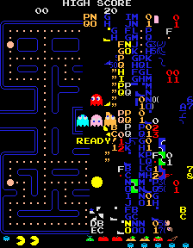
The Most Famous Integer Wrap Fault
Level 256 in PacMan
  thought to be unreachable…

Slide 14
Unsigned Integer Wrap Example
Faulty
void addThem(unsigned int ui_a, unsigned int ui_b) {
unsigned int ui_sum = ui_a + ui_b;
/* ... */
}

Slide 15
Unsigned Integer Wrap Example
Correct
#include <limits.h>
void addThem(unsigned int ui_a, unsigned int ui_b) {
unsigned int ui_sum;
if (UINT_MAX - ui_a < ui_b) {
/* Handle error */
} else {
ui_sum = ui_a + ui_b;
}
/* ... */
}
This is a
‘pre-condition’ test
In lab design a
post-condition test

Slide 16
Unsigned Integer Wrap Example
Better
#include <limits.h>
#include <inttypes.h>
void addThem(uint16_t ui_a, uint16_t ui_b) {
uint16_t ui_sum;
if (UINT16_MAX - ui_a < ui_b) {
/* Handle error */
} else {
ui_sum = ui_a + ui_b;
}
/* ... */
}
This is a
‘pre-condition’ test
In lab design a
post-condition test

Slide 17
Unsigned Integer Wrap Example
Not just faulty, potentially dangerous
  May create exploitable code
  e.g.: buffer overflow
void storeValues(unsigned int ui_a, unsigned int ui_b) {
unsigned int ui_sum = ui_a + ui_b;
stuff->aBuffer = malloc ( ui_sum * sizeof(float) );
/* use of aBuffer (that may be too small) here…*/
}

Slide 18
Side Note: Variable Names
OK, you use uint16_t or int32_t now
  But: the variable is just called ‘x’
  So: how can you know later in your code how many bits ‘x’ is long and what type it actually is?
  Answer: give variables a meaningful name that includes the amount of bits and the type, e.g.
    uint16_t ui16_x;
    int64 i64_length;
    float f_hight; // floats are standardised to 32 bits, no need for ‘f32_’
    double d_width; // doubles are standardised to 64 bits
  Naming rules like this (there are many versions) are enforced in many companies in the computing industry

Slide 19

Integer Vulnerabilities
Lang. | Description | Severity | Likelihood | Remediation Cost | Risk
C | Unsigned integer wrap | 3 | 3 | 3 | 27
C | Signed integer overflows | 3 | 3 | 3 | 27
C | Loss of data due to type-casting | 3 | 2 | 3 | 18
C | Division and remainder resulting in divide-by-zero | 1 | 3 | 2 | 6
C | Integer <–> pointer conversions | 1 | 2 | 3 | 6
C++ | Out of range enumeration values | 2 | 1 | 2 | 4
C | Negative bit shifts | 1 | 1 | 2 | 2
C | Incorrect integer precisions | 1 | 1 | 2 | 2
Table data source CERT.org
Possible Values: 1, 2, 3, 4 6, 8, 9 12, 18, 27
Note: ‘C’ in above table means ‘C and C++’

Slide 20
Signed Integer Overflow
Operators that can cause signed integer overflow
+ | Yes | -= | Yes | << | Yes | < | No
- | Yes | *= | Yes | >> | No | > | No
* | Yes | /= | Yes | & | No | >= | No
/ | Yes | %= | Yes | | | No | <= | No
% | Yes | <<= | Yes | ^ | No | == | No
++ | Yes | >>= | No | ~ | No | != | No
-- | Yes | &= | No | ! | No | && | No
= | No | |= | No | unary + | No | || | No
+= | Yes | ^= | No | unary - | Yes | ?: | No
Table data source: CERT.org

Slide 21
Signed Integers
C++ types
  char
  short int
  int
  long int
  long long int (C++11)
And the rub again:
  The amount of bytes in the above types depends on compiler and platform used
It’s not that simple

Slide 22
Signed Integers
Therefore use C99 (or higher) data types
  In C: <inttypes.h>, C++: cinttypes header
  (alternatively: C: <stdint.h>, C++: cstdint header)
  Defined length → portability & compiler independence
good for ‘if’ checks
e.g. int64_t x=5;
From Wikipedia:

Slide 23
Signed Integer Overflow
The number 14 in computer memory:
16 bit
Sign bit
1 byte
1 byte
0 | 0 | 0 | 0 | 0 | 0 | 0 | 0 | 0 | 0 | 0 | 0 | 1 | 1 | 1 | 0
16,284
128
16
8
4
2
1
2¹⁵
2⁷
2²
2¹
2⁰
8 + 4 + 2 = 14

Slide 24
Signed Integer Overflow
The biggest positive 16 bit signed integer:
16 bit
Sign bit
1 byte
1 byte
0 | 1 | 1 | 1 | 1 | 1 | 1 | 1 | 1 | 1 | 1 | 1 | 1 | 1 | 1 | 1
16,284
128
16
8
4
2
1
2¹⁵
2⁷
2²
2¹
2⁰
16,284 + 8,192 + . . . . + 16 + 8 + 4 + 2 + 1 = 32,767

Slide 25
Signed Integer Overflow
What happens if we add just one more ?
16 bit
Sign bit
1 byte
1 byte
0 | 1 | 1 | 1 | 1 | 1 | 1 | 1 | 1 | 1 | 1 | 1 | 1 | 1 | 1 | 1
16,284
128
16
8
4
2
1
2¹⁵
2⁷
2²
2¹
2⁰
16,284 + 8,192 + . . . . + 16 + 8 + 4 + 2 + 1 = 32,767

Slide 26


Signed Integer Overflow
What happens if we add just one more ?
#include <stdio.h>
int main()
{
short x = 32767;
printf("The short is now: %d \n", x);
x=x+1;
printf("And now: %d Oh! ", x);
return 0;
}

Slide 27
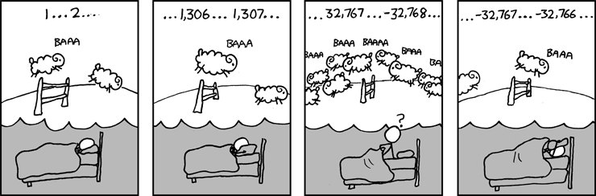
Signed Integer Overflow
What happens if we add just one more ?
Source: Can’t Sleep http://xkcd.com/571/

Slide 28
Signed Integer Overflow
We created the biggest negative 16 bit signed integer:
16 bit
Sign bit
1 byte
1 byte
1 | 0 | 0 | 0 | 0 | 0 | 0 | 0 | 0 | 0 | 0 | 0 | 0 | 0 | 0 | 0
16,284
128
16
8
4
2
1
2¹⁵
2⁷
2²
2¹
2⁰
-32,768 + 0 + 0 + 0 + ….. + 0 + 0+ 0 + 0 = -32,768

Slide 29
Signed Integer Overflow
And -1 is:
16 bit
Sign bit
1 byte
1 byte
1 | 1 | 1 | 1 | 1 | 1 | 1 | 1 | 1 | 1 | 1 | 1 | 1 | 1 | 1 | 1
16,284
128
16
8
4
2
1
2¹⁵
2⁷
2²
2¹
2⁰
-32,768 + 16,284 + ….. + 16 + 8 + 4 + 2 + 1 = -1

Slide 30
Signed Integer Overflow
And -2 is:
16 bit
Sign bit
1 byte
1 byte
1 | 1 | 1 | 1 | 1 | 1 | 1 | 1 | 1 | 1 | 1 | 1 | 1 | 1 | 1 | 0
16,284
128
16
8
4
2
1
2¹⁵
2⁷
2²
2¹
2⁰
-32,768 + 16,284 + ….. + 16 + 8 + 4 + 2 + 0 = -2

Slide 31
Signed Integer Overflow
Therefore
  Not a wrap but an overflow
And another rub:
  The C and C++ standards do not define how compilers should encode an overflow.
  The behaviour on the last slides is the most common one, but not the only one possible
  Signed integer overflow is therefore undefined behaviour

Slide 32

Signed Integer Overflow Example
Faulty
void addThem(int si_a, si_b) {
int si_sum = si_a + si_b;
/* ... */
}

Slide 33
Signed Integer Overflow Example
Better
#include <inttypes.h>
void addThem(int16_t si_a, int16_t si_b) {
int16_t si_sum;
if (((si_b > 0) && (si_a > (INT16_MAX - si_b))) ||
((si_b < 0) && (si_a < (INT16_MIN - si_b)))) {
/* Handle error */
} else {
si_sum = si_a + si_b;
}
/* ... */
}
In lab design tests for:
Subtraction
Multiplication
Division

Slide 34
In The Lab
Operators you write secure methods for
(to be used in coursework)
+ | Yes | -= | Yes | << | Yes | < | No
- | Yes | *= | Yes | >> | No | > | No
* | Yes | /= | Yes | & | No | >= | No
/ | Yes | %= | Yes | | | No | <= | No
% | Yes | <<= | Yes | ^ | No | == | No
++ | Yes | >>= | No | ~ | No | != | No
-- | Yes | &= | No | ! | No | && | No
= | No | |= | No | unary + | No | || | No
+= | Yes | ^= | No | unary - | Yes | ?: | No
Table data source: CERT.org

Slide 35
Integer Vulnerabilities
Lang. | Description | Severity | Likelihood | Remediation Cost | Risk
C | Unsigned integer wrap | 3 | 3 | 3 | 27
C | Signed integer overflows | 3 | 3 | 3 | 27
C | Loss of data due to type-casting | 3 | 2 | 3 | 18
C | Division and remainder resulting in divide-by-zero | 1 | 3 | 2 | 6
C | Integer <–> pointer conversions | 1 | 2 | 3 | 6
C++ | Out of range enumeration values | 2 | 1 | 2 | 4
C | Negative bit shifts | 1 | 1 | 2 | 2
C | Incorrect integer precisions | 1 | 1 | 2 | 2
Table data source CERT.org
Possible Values: 1, 2, 3, 4 6, 8, 9 12, 18, 27
Note: ‘C’ in above table means ‘C and C++’

Slide 36
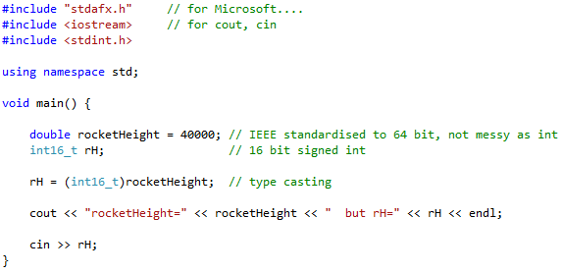

Type-Casting Error
Very simple

Slide 37
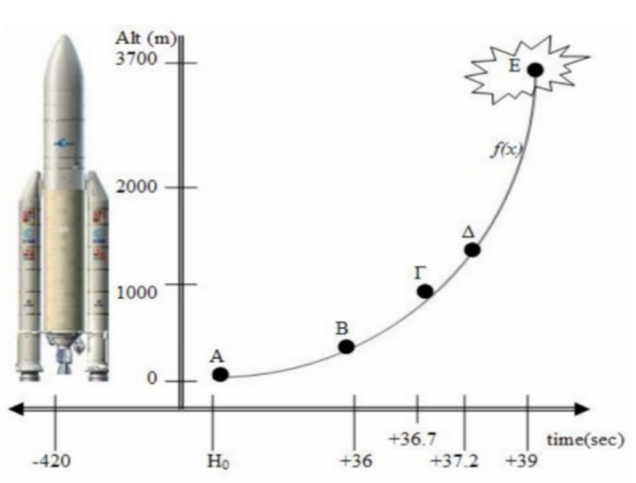
Type-Casting Error
Ariane 5 Rocket
10 year of development £5b
June 4, 1996, first launch
Exploded 40s after lift-off
Rocket & cargo value: £350m
Cause of the failure:
  software error in the inertial reference system
  the 64 bit floating point number of horizontal speed was converted to a 16 bit signed integer (type-casting).
  The number was larger than 32,767 (i.e. the largest int storeable in a 16 bit signed int) and thus the conversion failed.
Graphic from: Dharshana Kasun Warusavitharana

Slide 38
Integer Vulnerabilities
Lang. | Description | Severity | Likelihood | Remediation Cost | Risk
C | Unsigned integer wrap | 3 | 3 | 3 | 27
C | Signed integer overflows | 3 | 3 | 3 | 27
C | Loss of data due to type-casting | 3 | 2 | 3 | 18
C | Division and remainder resulting in divide-by-zero | 1 | 3 | 2 | 6
C | Integer <–> pointer conversions | 1 | 2 | 3 | 6
C++ | Out of range enumeration values | 2 | 1 | 2 | 4
C | Negative bit shifts | 1 | 1 | 2 | 2
C | Incorrect integer precisions | 1 | 1 | 2 | 2
Self Study
(aka ‘homework’)
Table data source CERT.org
Possible Values: 1, 2, 3, 4 6, 8, 9 12, 18, 27
Note: ‘C’ in above table means ‘C and C++’

Slide 39
End of Lecture

